Slide 1
Welcome to Public Health 403
Obesity: From Cells to Society

Slide 2
Your Instructional Team
Kate Bauer
Dave Bridges

Slide 3
Who are YOU?
What motivated you to take this class?
What is something you really want to gain from taking this class?
Notes:
Affinity for different disciplines
Major
Taken Stats
Taken Biology
Written Research Paper Why this class (post it notes)

Slide 4
Some Topics We Will Cover
Very Interested
Kind of Interested
Neutral
Not Interested
Social and Cultural Perceptions of Obesity
Social Determinants of Obesity
Biological and Genetic Determinants of Obesity
The Role of the Physical Environment in Obesity
Obesity and Chronic Health Problems
Diets and Weight Loss Strategies
Obesity and Global Health
Policy and community approaches to obesity prevention
Behaviors that Contribute to Obesity
Social and Cultural Perceptions of Obesity
Social Determinants of Obesity
Biological and Genetic Determinants of Obesity
The Role of the Physical Environment in Obesity
Obesity and Chronic Health Problems
Diets and Weight Loss Strategies
Obesity and Global Health
Policy and community approaches to obesity prevention
Behaviors that Contribute to Obesity

Slide 5
This Course
Three main topics
Causes and trends in obesity
Related chronic health outcomes
Interventions and policy approaches

Slide 6
Class Format
2 Lectures per week, often one by each of us
Lots of discussions and activities

Slide 7
This class Aspires to be a conversation

Slide 8
OBESITY AND HOW WE TALK ABOUT IT
Obesity can be hard to talk about.
Words and perspectives that don’t bother one person, may bother another.
We expect everyone in this course to come from a place of empathy and consideration.
We won’t all be perfect all the time.
We will try to model for you sensitive perspectives and language
Describing individuals with obesity
Stigmatizing perspectives
If we see any issues, we will reach out to you
Please share with us
Notes:
Inclusive teaching guidelines discussion points
This is going to be hard, we expect people to be considerate.
Misconceptions of obesity.
We will try to model appropriate behaviors and language.
If we see any issues, we will reach out to you. Please talk to us.
Handout from CRLT, discuss amongst each other and how it relates to this course.

Slide 9
Guidelines for class discussions
Be aware of how much you are contributing to in-class discussions.
Listen respectfully.
Take pair work or small group work seriously.

Slide 10
Guidelines for class discussions
Be aware of how much you are contributing to in-class discussions. Try not to silence yourself out of concern for what others will think about what you say. If you have an idea, don’t wait for someone else to say it; say it yourself. If you tend to contribute often, give others the opportunity to speak.
Listen respectfully. Don’t interrupt, engage in private conversations, or turn to technology while others are speaking. Use attentive, courteous body language. Comments that you make should reflect that you’ve paid attention to the previous speakers’ contributions.
Take pair work or small group work seriously. Remember that your peers’ learning partly depends upon your engagement.

Slide 11
Guidelines for class discussions
Support your statements.
Understand that there are different approaches to solving problems.
Respect others’ right to hold opinions and beliefs that differ from your own.
Make an effort to get to know other students.

Slide 12
Obesity can be hard to talk about
Obesity is a stigmatized condition.
We expect everyone in this course to come from a place of empathy and consideration.
We will try to model for you sensitive and diverse, perspectives and language.
Notes:
Give a couple of examples
Try a student centered example
Inclusive teaching guidelines discussion points
This is going to be hard, we expect people to be considerate.
Misconceptions of obesity.
We will try to model appropriate behaviors and language.
If we see any issues, we will reach out to you. Please talk to us.
Handout from CRLT, discuss amongst each other and how it relates to this course.

Slide 13
Guidelines for class discussions
Support your statements. Use evidence and provide a rationale for your points.
Understand that there are different approaches to solving problems. If you are uncertain about someone else’s approach, ask a question to explore areas of uncertainty. Listen respectfully to how and why the approach could work.
Respect others’ right to hold opinions and beliefs that differ from your own. Be open to hearing their perspectives. Be open to changing your perspectives based on what you learn from others. Be okay with disagreement.
Make an effort to get to know other students. Introduce yourself to students sitting near you. Refer to classmates by name and make eye contact with other students.

Slide 14
Class Rules
No laptops, phones, tablets, etc.
We will provide slides beforehand
Purchase and register an iClicker
This will be used for participation purposes but not for grading

Slide 15
What is the best hockey team in the world?
Detroit Red Wings
Toronto Maple Leafs
Montreal Canadiens
Pittsburgh Penguins

Slide 16
Field Trip!
Demonstration of methods for determining body composition on 11 Sept
Will meet at the MCRU in the Cardiovascular Center (directions on Canvas)
If you would like to participate (i.e. be assessed) please email Dave (davebrid@umich.edu) by Noon on Wednesday

Slide 17
How to Win at PUBHLTH403
Come to class prepared to engage
Read/View the Required Pre-Class Materials posted on each Canvas page before class
There are also Further Readings, you do not have to read those before class they are for those interested in a topic, or if it is of use to your writing project.
Speak up, this is complex materials. Sometimes there is no right answer!

Slide 18
How will you be assessed
Participation – 10%
News Assignments – 15%
Writing Project – 40%
Midterms – 40%

Slide 19
Participation
10 points out of your final grade
Right now, you are all at 7
We will be tick you up or down through the semester

Slide 20
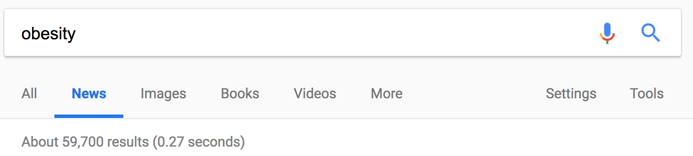
News Assignments
Obesity is in the news
How do we think critically about these reports?
Are they based on some research?
Was the news report accurate? Overhyped? Biased?

Slide 21
News Assignment - How
Find a news article that interests you. Think about where or how it fits into this class
Sign up for a presentation date on http://bit.ly/403news
2 weeks before: Submit link to news source, and research article
48h before: Submit a brief summary of the article (5 % of final grade)
Template for summary on Canvas
Introduction to topic
Summary of the news article
Alignment with the scientific source
Implications

Slide 22
NEWS Assignment – The big day
Dave or Kate will let you know when in the lecture is your time to shine
You will have ten minutes to present your article
Moderate a five minute discussion with your classmates
Think of some leading questions to get folks talking

Slide 23
NEWS Assignment – Other’s News
Read the news article and the research article before class
Come prepared with questions, comments for the presenter

Slide 24
Can you give me an Example?
Yes! Next lecture on the Genetics of Obesity
Notes:
Add in the activity about stand in the line

Slide 25
NEWS assignment - Grading
Grade will be based on
Clarity
Directness
Presentation Quality
Comfort with Topic
Quality of the Discussion
Presentation worth 10% of your overall grade

Slide 26
Writing Project
Dig deep into a topic and relate it to public health
Present a compelling, evidence-based argument for a solution to a problem in the area of obesity.
The obesity-related problems/solutions may be one of surveillance, identification, implementation, or evaluation.
Details on Canvas http://bit.ly/403writing

Slide 27
Writing Project – Key Dates
October 18: Presenting initial idea to class
November 14: First drafts of essay are due
November 21: Peer reviews due
December 7: Final versions due

Slide 28
How DO I get Started?
Some Topic Ideas
Advocating for a new food pantry to address obesity in low-income communities
Testing the impact of employee wellness programs on obesity
Advocating for a new measure of adiposity to be measured in NHANES
Testing an effective pharmaceutical treatment for obesity
Incentivizing supermarkets to subsidize produce for obesity prevention
Implementing an anti obesity stigma marketing campaign
Taxing foods and drinks by sugar content
Limiting portion sizes sold at chain restaurants
Limiting fertility treatments to women without obesity
Providing financial incentives for weight loss
Restricting junk food sales at stores near elementary schools
Offering new parents free classes on child nutrition
Eliminating soft drink advertising at sporting events
Removing fast food restaurants from college campuses
Worksites providing treadmill desks to all employees
Childcare policies that restrict what parents can send for children to eat

Slide 29
BUT
The best topic is something you are passionate about!

Slide 30
Exams
Two of them
October 11th In class – Covers Causes of Obesity
December 19th (10:30 AM) during finals period – Covers Consequences, Prevention and Treatments for Obesity
Not cumulative, but may rely on prior concepts
Review session will be held the class before

Slide 31
The Current State of Obesity
Definitions, prevalence, and disparities

Slide 32
Learning Objectives
Define obesity, overweight and class 2 and 3 obesity and how this is assessed.
Describe the scope of obesity as a public health problem.
Understand how BMI percentiles and growth charts are used to assess childhood obesity.

Slide 33
What is obesity?
Excess adipose (fat) tissue
Determined to be a disease by the American Medical Association
Identified among adults using BMI
Weight (kg)/Height (m²)
BMI <= 18.5 = underweight
BMI >18.5 to <25 = ”normal weight”
BMI 25 to <30 = overweight
BMI 30 to < 35 = obese (class I)
BMI 35 to < 40 = obesity (class II)
BMI > 40 = obesity (class III)

Slide 34
BMI is…
A. Very informative
B. Totally useless
C. It depends
D. I don’t know

Slide 35
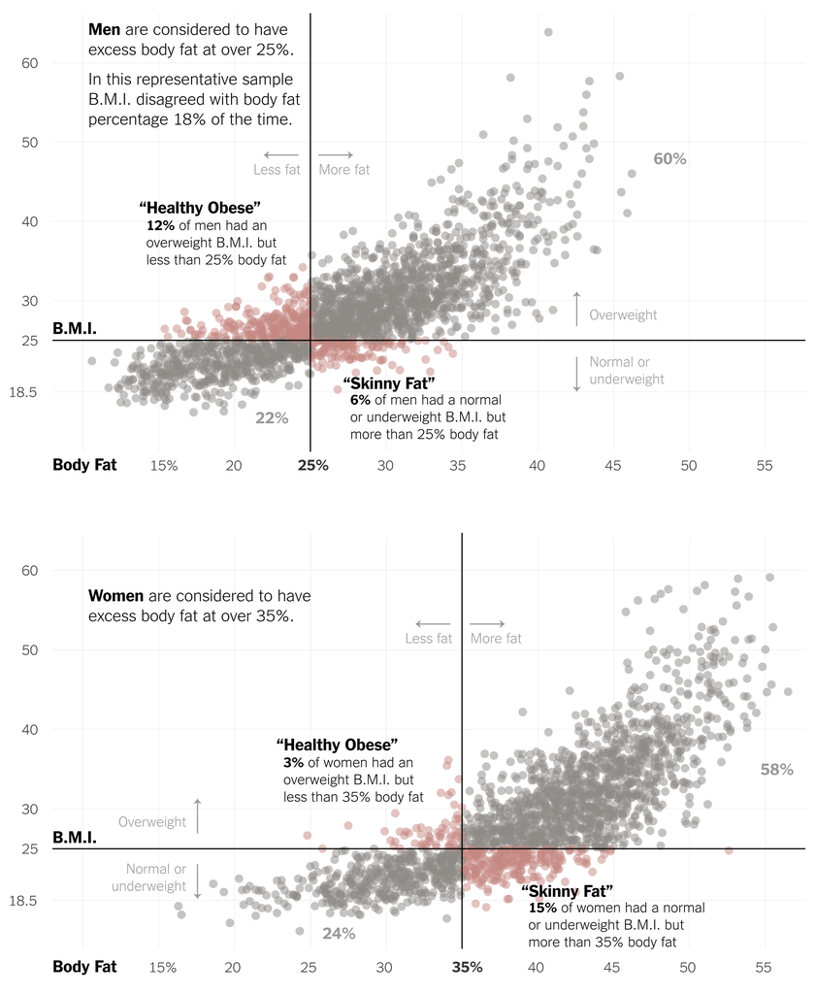

Slide 38
Obesity is more prevalent in the US than in Canada

Slide 40
Are individuals of low socioeconomic status more likely to have obesity?
Yes
No
It depends
I don’t know

Slide 41
Relationship between education and obesity prevalence differs differently by race/ethnicity

Slide 42
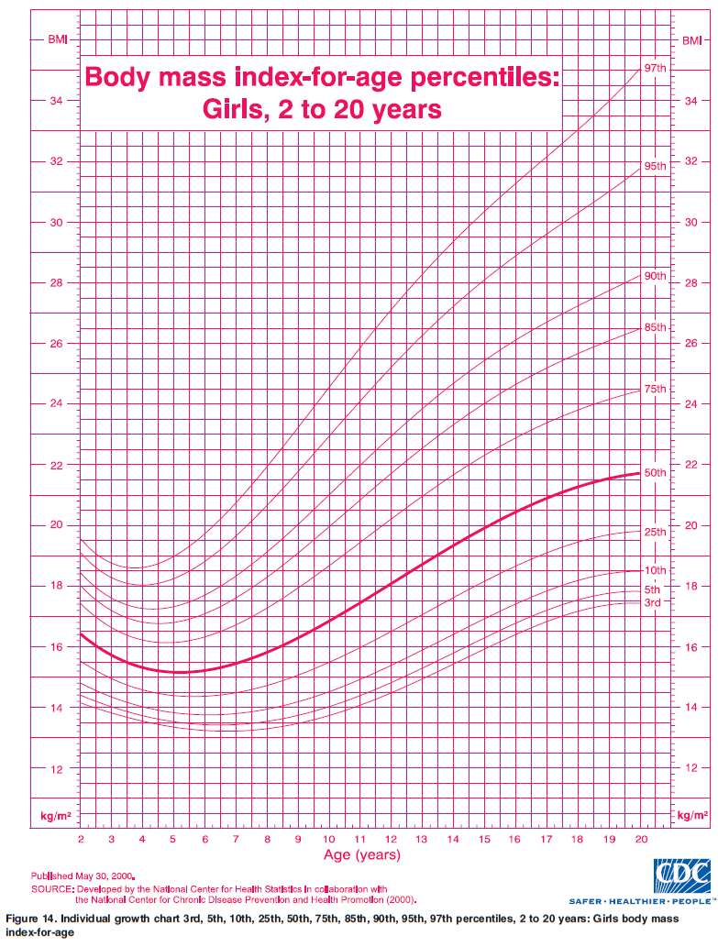
Body Mass Index in Children
Obesity in Children
Because children are expected to grow, and this growth is sex-specific, we use growth charts to identify high BMI among children

Slide 43
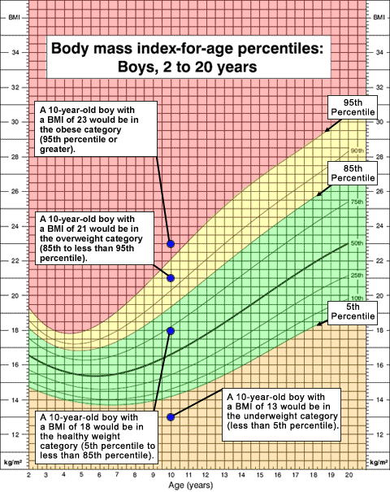
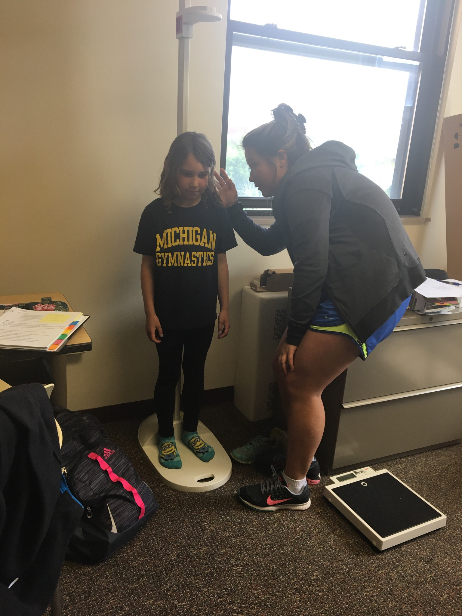
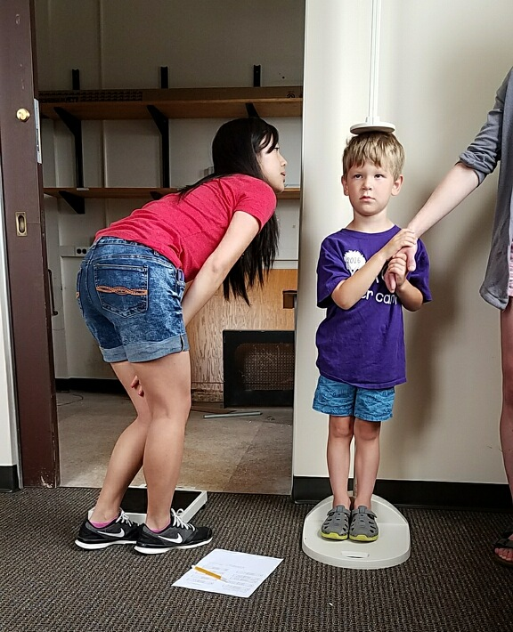
BMI percentiles do not work well to track children above the 95th percentile; use % of the 95th instead of 97th, 99th, etc.
Severe obesity in children is defined as having a BMI >=120% of the 95th percentile
Notes:
Maybe include a chart summarizing.

Slide 44
Obesity is more prevalent among children in the US vs. Canada among all age groups

Slide 45
Prevalence of obesity among children in the US by sex and race/ethnicity

Slide 46
What about children under 2?
Weight for length is used to identify high weight in children 0-2
Although definitions of obesity are not official for this age, > 98th percentile indicates high weight for length
Use of WHO (vs. CDC) growth charts recommended

Slide 47
WHO vs. CDC growth charts for US children < 2 years, 1999-2004

Slide 48
Key Points
Obesity is a disease of high adiposity, identified through BMI, BMI percentile, or weight for length.
BMI is not perfect, but works to identify excess adiposity on a population level.
BMI cannot be directly used to measure obesity among children because different amounts of fat are expected and healthy at different ages and by child sex.
Overall in the US, 34% of adults and 17% of children have obesity.
Disparities in obesity prevalence by socioeconomic status, sex, race, and ethnicity predominantly exist due to social forces.

